Slide 1

Sharing your Data on Campus
Recommendations
This PowerPoint can be used to communicate a high-level view of student risk, receptivity and requests for support.
Use it as is and/or supplement with other relevant campus information:
Historical retention rates
Net tuition revenue per student
Cost of attrition
Comparisons of your retention and graduation rates with your peers and aspirant institutions
We recommend sharing this information at opening faculty meetings, with academic advisors, with department chairs (you can do additional graphics with just specific majors), the retention task force, and parents (in particular, the Top Ten Requests for Assistance).

Slide 2
CSI Form B - Instructions
Log in to your Retention Data Center
Calculate your completion rate using the number of completed students out of the total number of students in your incoming class. If a student file was uploaded, this is displayed on your Dashboard.
Under the Summary Results tab - Generate a Summary Report for your intended cohort (the entire incoming class or subsections). Adjust your students by clicking the Change View button or apply a filter using the drop-down menu.
Use the Summary Report to populate the PowerPoint Slides for the CSI Form B. The chart on the right indicates which page of the Summary Report the variables can be found. Note – if you have populated this information on your “Toolkit” it can also be found there.
When complete, delete this instruction page and any slides that are not applicable for your implementation.
 | Summary Report Section
Overall Risk Index | Summary and Observations – Page 2
Predicted Academic Difficulty | Summary and Observations – Page 2
Educational Stress | Summary and Observations – Page 2
Receptivity to Institutional Help | Summary and Observations – Page 2
Key Characteristics | Demographics – Page 2
Top 10 Requests for Assistance | Recommendations – Page 3

Slide 3
CSI Form C - Instructions
Log in to your Retention Data Center
Calculate your completion rate using the number of completed students out of the total number of students in your incoming class. If a student file was uploaded, this is displayed on your Dashboard.
Under the Summary Results tab - Generate a Summary Report for your intended cohort (the entire incoming class or subsections). Adjust your students by clicking the Change View button or apply a filter using the drop-down menu.
Use the Summary Report to populate the PowerPoint Slides for the CSI Form C. The chart on the right indicates which page of the Summary Report the variables can be found. Note – if you have populated this information on your “Toolkit” it can also be found there.
When complete, delete this instruction page and any slides that are not applicable for your implementation.
 | Summary Report Section
Overall Risk Index | Summary and Observations – Page 2
Acknowledged Academic Needs Index | Summary and Observations – Page 2
Apprehension Index | Summary and Observations – Page 2
Receptivity Index | Summary and Observations – Page 2
Key Characteristics | Demographics – Page 2
Top 10 Requests for Assistance | Recommendations – Page 3

Slide 4
MYSA Forms B and C - Instructions
Log in to your Retention Data Center
Calculate your completion rate using the number of completed students out of the total number of students in your incoming class. If a student file was uploaded, this is displayed on your Dashboard.
Under the Summary Results tab - Generate a Summary Report for your intended cohort (the entire incoming class or subsections). Adjust your students by clicking the Change View button or apply a filter using the drop-down menu.
Use the Summary Report to populate the PowerPoint Slides for the Mid-Year Student Assessment. The chart on the right indicates which page of the Summary Report the variables can be found.
When complete, delete this instruction page and any slides that are not applicable for your implementation.
 | Summary Report Section
Areas of Growth | Primary Sample Statistics – Page 2
Resources Used and Want | Students' Needs and Interests – Page 3
Key Characteristics | Demographics – Page 5 & 6
Student Satisfaction | Institutional Impressions – Page 4

Slide 5
Identification of student risk, receptivity and outreach prioritization
College Student Inventory™ Summary Results, Fall 20XX Cohort
Institution Name
N =
XX
Completion Rate =
XX%

Slide 6



Are our students more or less at risk than their peers nationally?
Campus results below are mean percentile scores
Overall Risk Index
Predicted Academic Difficulty
Total
Females
Males
Total
Females
Males
Low Risk
Low Risk
>50
XX
XX
XX
>50
XX
XX
XX
High Risk
High Risk
<50
<50
XX%
of students are highest rick
(80th percentile or higher)
XX%
of students are highest risk
(80th percentile or higher)
Low Risk
Total
Females
Males
Educational
Stress
XX%
>50
XX
XX
XX
High Risk
<50
of students are highest risk
(80th percentile or higher)

Slide 7
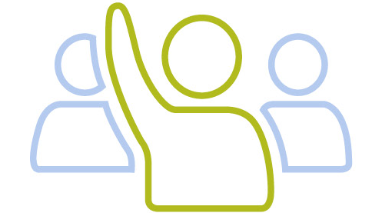
Are our students more receptive to assistance?
Receptivity to institutional help
Total
Females
Males
Low Receptivity
>50
High Receptivity
XX
XX
XX
<50
XX%
of students are most receptive
(80th percentile or higher)

Slide 8
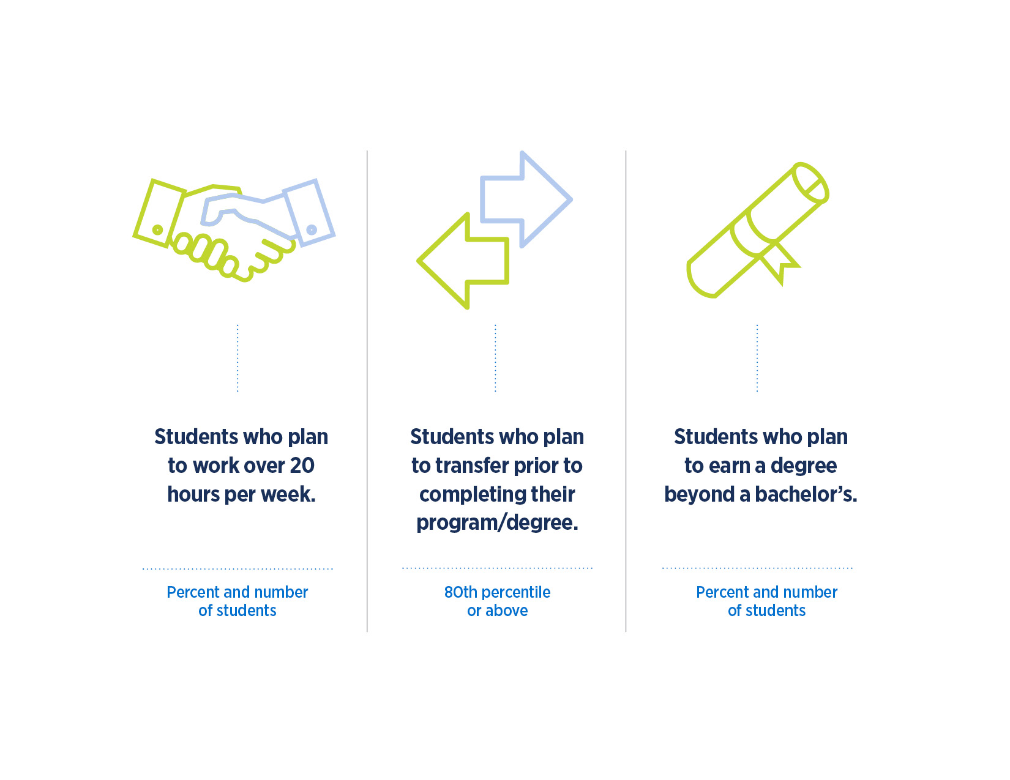
What are some key characteristics of this incoming class?
%
N
%
N
%
N
Students who plan to work over 20 hours per week.
Students who plan to transfer prior to completing their program/degree.
Students who plan to earn a degree beyond a bachelor’s.
Percent and number of students
80th percentile or above
Percent and number of students

Slide 9
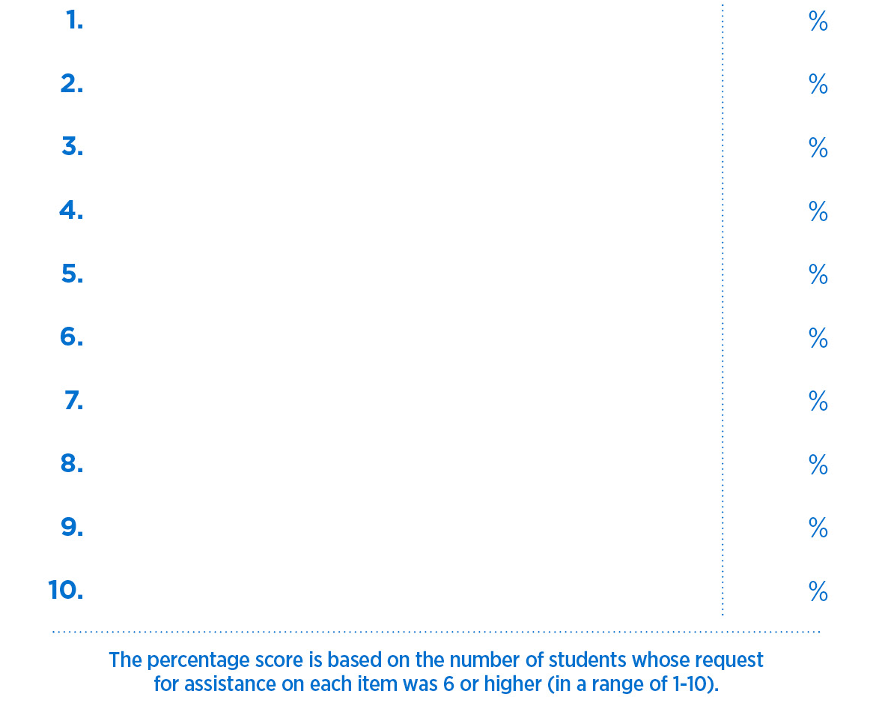

Students’ top 10 requests for assistance
First request
XX
Second request
XX
Third request
XX
Fourth request
XX
(Get Help/Discuss/Get Info)
Fifth request
XX
Sixth request
XX
Seventh request
XX
Eight request
XX
Ninth request
XX
Tenth request
XX

Slide 10

How are we using this information?
Ways in which we are using these data:
List ways

Slide 11
How are we using this information?
Goals/Outcomes that we have set/achieved (optional):
List goals/outcomes (optional)

Slide 12
One-page version of the infographic?

Slide 13

Are our students more or less at risk than their peers nationally?
What are some key characteristics of this incoming class?
College Student Inventory™ Summary Results Fall 20XX Cohort Institution Name Completion Rate = N =
Campus results below are mean percentile scores
Overall Risk Index
XX%
XX
Low Risk
Females
Males
Total
Students’ top 10 requests for assistance
>50
XX
XX
XX
%
N
%
N
%
N
High Risk
XX%
of students are highest risk (80th percentile or higher)
(Get Help/Discuss/Get Info)
<50
Students who plan to work over 20 hours per week.
Students who plan to transfer prior to completing their program/degree.
Students who plan to earn a degree beyond a bachelor’s.
Request
XX
%
1.
Request
XX
%
2.
Predicted Academic Difficulty
Request
XX
%
Percent and number of students
80th percentile or above
Percent and number of students
3.
Low Risk
Females
Request
XX
%
Males
Total
4.
>50
XX
XX
XX
Request
XX
%
of students are highest risk (80th percentile or higher)
5.
High Risk
XX%
Are our students more receptive to assistance?
Request
XX
%
<50
6.
Request
XX
%
Receptivity to institutional help
7.
Educational Stress
Request
XX
%
Females
Males
Total
8.
Low Receptivity
Low Risk
Females
Total
>50
XX
XX
XX
Request
XX
%
Males
of students are most receptive
(80th percentile or higher)
9.
>50
XX
XX
XX
High Receptivity
XX%
of students are highest risk (80th percentile or higher)
10.
Request
XX
%
High Risk
XX%
<50
<50
The percentage score is based on the number of students whose request for assistance on each item was 6 or higher (in a range of 1-10).

Slide 14
Identification of student risk, receptivity and outreach prioritization
College Student Inventory™ Summary Results, Fall 2025 Cohort
SCHOOL NAME
N =
XX
Completion Rate =
XX%

Slide 15
Are our students more or less at risk than their peers nationally?
Campus results below are mean percentile scores
Overall Risk Index
Acknowledged Academic Needs Index
Total
Females
Males
Total
Females
Males
Low Risk
Low Risk
>50
XX
XX
XX
>50
XX
XX
XX
High Risk
High Risk
<50
<50
XX%
of students are highest rick
(80th percentile or higher)
XX%
of students are highest risk
(80th percentile or higher)
Low Risk
Total
Females
Males
XX%
Apprehension
Index
>50
XX
XX
XX
High Risk
<50
of students are highest risk
(80th percentile or higher)

Slide 16
Are our students more receptive to assistance?
Receptivity Index
Total
Females
Males
Low Receptivity
>50
High Receptivity
XX
XX
XX
<50
XX%
of students are most receptive
(80th percentile or higher)

Slide 17
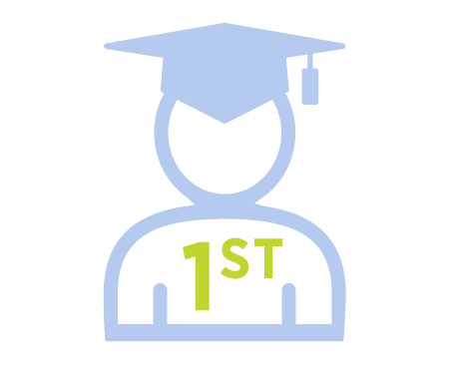
What are some key characteristics of this incoming class?
%
N
%
N
%
N
Students who plan to work over 20 hours per week.
Students who plan to transfer prior to completing their program/degree.
First-Generation Students
Percent and number of students
80th percentile or above
Percent and number of students

Slide 18
Students’ top 10 requests for assistance
First request
XX
Second request
XX
Third request
XX
Fourth request
XX
(Get Help/Discuss/Get Info)
Fifth request
XX
Sixth request
XX
Seventh request
XX
Eight request
XX
Ninth request
XX
Tenth request
XX

Slide 19
How are we using this information?
Ways in which we are using these data:
List ways

Slide 20
How are we using this information?
Goals/Outcomes that we have set/achieved (optional):
List goals/outcomes (optional)

Slide 21
One-page version of the infographic?

Slide 22
Are our students more or less at risk than their peers nationally?
What are some key characteristics of this incoming class?
College Student Inventory™ Summary Results Fall 20XX Cohort Institution Name Completion Rate = N =
Campus results below are mean percentile scores
Overall Risk Index
XX%
XX
Low Risk
Females
Males
Total
Students’ top 10 requests for assistance
>50
XX
XX
XX
%
N
%
N
%
N
High Risk
XX%
of students are highest risk (80th percentile or higher)
(Get Help/Discuss/Get Info)
<50
Students who plan to work over 20 hours per week.
Students who plan to transfer prior to completing their program/degree.
First Generation Students
Request
XX
%
1.
Request
XX
%
2.
Acknowledged Academic Needs Index
Request
XX
%
Percent and number of students
80th percentile or above
Percent and number of students
3.
Low Risk
Females
Request
XX
%
Males
Total
4.
>50
XX
XX
XX
Request
XX
%
of students are highest risk (80th percentile or higher)
5.
High Risk
XX%
Are our students more receptive to assistance?
Request
XX
%
<50
6.
Request
XX
%
Receptivity Index
7.
Apprehension
Index
Request
XX
%
Females
Males
Total
8.
Low Receptivity
Low Risk
Females
Total
>50
XX
XX
XX
Request
XX
%
Males
of students are most receptive
(80th percentile or higher)
9.
>50
XX
XX
XX
High Receptivity
XX%
of students are highest risk (80th percentile or higher)
10.
Request
XX
%
High Risk
XX%
<50
<50
The percentage score is based on the number of students whose request for assistance on each item was 6 or higher (in a range of 1-10).

Slide 23
Mid-way through the first year: What are your first-year students saying now?
Mid-Year Student Assessment™ Summary Results, Fall 2025 Cohort
SCHOOL NAME
N =
XX
Completion Rate =
XX%

Slide 24
In what areas have we seen growth and development in our students?
These are the areas in which our students saw the greatest growth in their first term
SCALE NAME
1.
One
2.
Two
3.
Three

Slide 25
What resources have our students used and what do they want next?
These are the top 3 areas students report getting assistance in their first semester.
These are the top 3 areas in which students are requesting assistance now (for next term).
1.
One
1.
One
2.
Two
2.
Two
3.
Three
3.
Three

Slide 26
What are some key characteristics of this incoming class?
Percent
Number of Students
Percent
Number of Students
XX%
XX
XX%
XX
Students who plan to work
over 20 hours per week.
Students who report they
“need a lot more time to
study than they expected.”

Slide 27
What are some key characteristics of this incoming class?
College plans
Percent
Number of Students
Percent
Number of Students
XX%
XX
XX%
XX
I plan to complete my degree/certificate at this college/university.
I plan to transfer to another
college/university to
complete my degree.
Percent
Number of Students
Percent
Number of Students
XX%
XX
XX%
XX
College is not right for me at
this time, and I do not plan
to re-enroll next term.
I have not made a
decision about my plans
for next term.

Slide 28
Student Satisfaction
Rank the 9 areas of student satisfaction from highest to lowest.
List

Slide 29
How are we using this information?
Ways in which we are using these data:
List ways

Slide 30
How are we using this information?
Goals/Outcomes that we have set/achieved (optional):
List goals/outcomes (optional)

