Slide 1
RNLNC 2025 Presentation Template Instructions
If you are building your conference presentation from scratch:
You can begin building your presentation within the template layouts built into this document. Layouts feature preformatted text boxes to assist in text style, size, color, and placement.
If you are converting an existing PowerPoint presentation to the RNLNC 2025 template:
Please refer to the instructions on the next three pages for help with formatting and troubleshooting.
Thank you for helping us create a consistent branded experience for conference attendees!

Slide 2
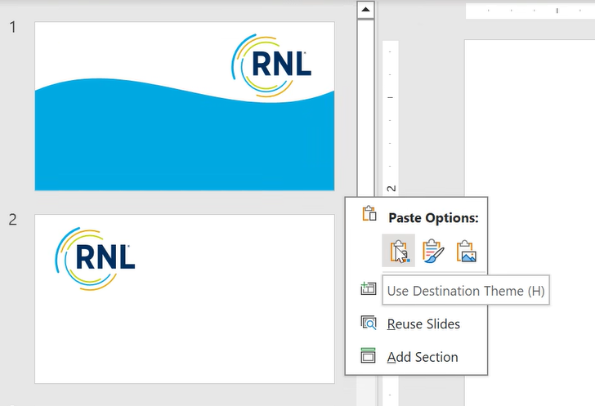
How to convert your slide deck
Step 1: Transfer slides from an existing presentation to the RNLNC 2025 template
Open your existing PowerPoint presentation. Additionally, open the RNLNC 2025 template. It is often easiest to work on files open side by side.
Go back to your existing presentation: In the slide thumbnails panel to the left, select all slides you want to convert and copy the slides (CTRL + C).
In the new template: In the slide thumbnails panel to the left, paste the old slides into the new template with the “Use Destination Theme” setting. This will ensure fonts and colors update easily.
To do this: Hover over the gray space between the slides in the slide thumbnail panel > Right-click > Under “Paste Options,” choose “Use Destination Theme.”
Your slides are now pasted into the RNLNC 2025 template file. Some fonts and colors may have changed. But they aren’t in the new template design yet. You need to assign each slide to a layout featured in the new template.
Please proceed to Step 2 on the following slide.
Right-click in here

Slide 3
How to convert your slide deck
Step 2: Assign slides to the RNLNC 2025 template layouts
You now have all your old slides pasted into the new template document. Let’s get them switched over to the new design!
To do this: Go to the slide thumbnails panel to the left. Right-click on each slide and apply a slide layout from the new template. You can click around to try out different options that best fit the old content.
Continue this process for all of the slides you pasted in from the old template. You can update a group of slides to the same layout at the same time by selecting multiple slides in the slide thumbnail panel.
For each slide you just added and applied the new template layout, select the "Reset Slide" option (located directly underneath “Layout”) to make sure as much content as possible is using the new template's colors, fonts, and layout placement. You’ll notice that some slide elements will snap into the correct position on the page.
PowerPoint cannot update everything automatically, but this process will get your slides very close to completion. Please see Step 3 for final design considerations.
Right-click slide to access Layout and Reset Slide functions

Slide 4
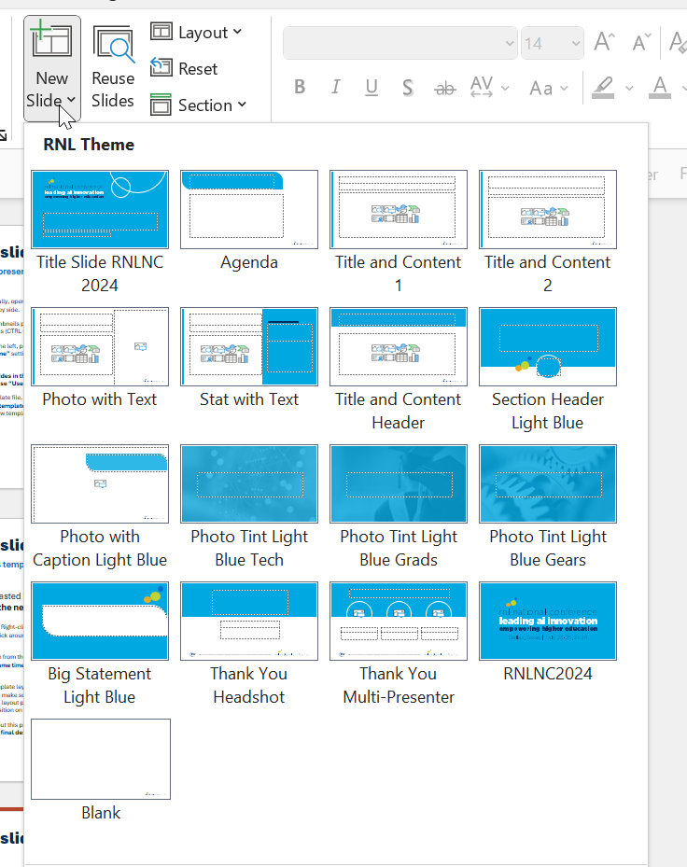
How to convert your slide deck
Part 3: Refine slide design
Check all copy to ensure it is in Aptos/Aptos Black. It may be helpful to use the “Replace Fonts” feature in the Home menu to replace incorrect fonts.
It’s best practice to compare your new slides to the old ones to ensure all notes, copy, comments, and graphics transferred over.
Review charts and graphs for readability and style. This may require manual adjustment of text, numbers, and colors depending on formatting of original chart.
Don’t have an existing slide deck? Starting from scratch?
You can skip this process! Simply begin building your presentation within this template using the assigned layouts, colors, and fonts.
To access all layouts: Home > New Slide > Select one of the RNLNC 2025 layouts.

