Slide 1
RNL Satisfaction Priorities Survey Results
Executive Summary Template
The SPS Executive Summary is not exportable but can easily be used as a stand-alone piece to share your results. To use our template:
Login to your RNL Client Reporting Portal
Pull up the desired report (Main Report, Single Group Report, or Versus Report)
Go to the Executive Summary Tab
Adjust your screen width so you can see as much of the screen as possible
On the next slide, replace the image in the upper right corner with your logo
On both slides, update the survey administration name
Open your snipping tool
Screenshot the top section of the Executive Summary (bottom line indicators and demographics)
Paste into the next slide (replacing the existing screenshot)
Screenshot the second section of the Executive Summary (strengths and challenges)
Paste into the final slide (replacing the existing screenshot)
Save as PDF or PowerPoint
If you are creating multiples, repeat steps 6-12.

Slide 2
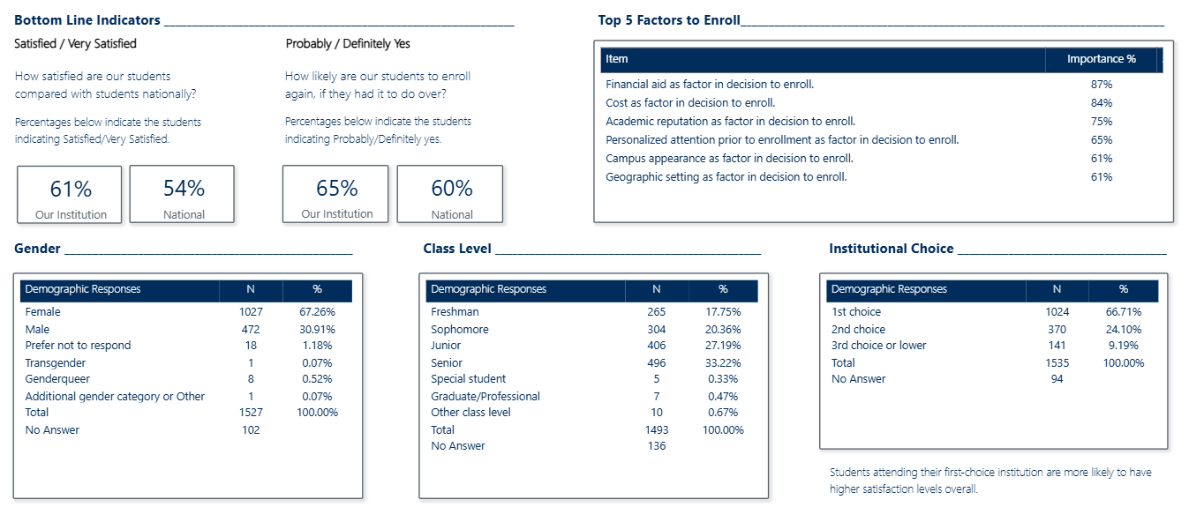
RNL Satisfaction Priorities Survey Results
Survey Administration Name
Your Logo
REPLACE WITH YOUR SCREENSHOT

Slide 3
RNL Satisfaction Priorities Survey Results
Survey Administration Name
REPLACE WITH YOUR SCREENSHOT

