Slide 1
Student Satisfaction and Priorities
Adult Student Priorities Survey™ (ASPS)

Slide 2
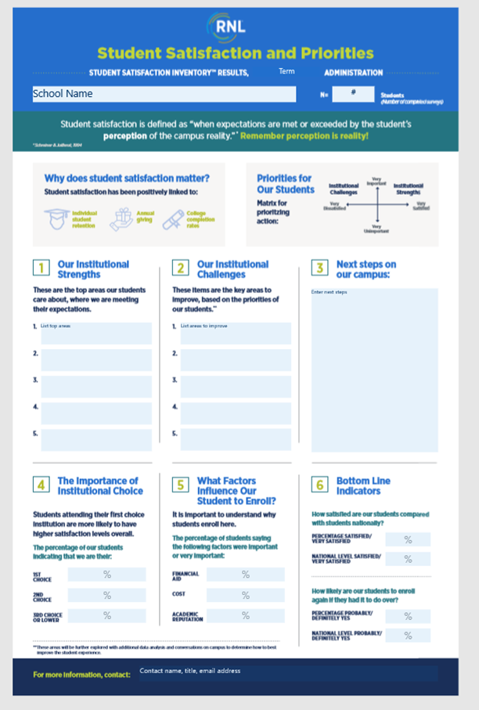
Student Satisfaction Inventory: Infographic
Use this PowerPoint template to match the data in the infographic.
Pull the same data points into this PowerPoint as you are highlighting in the infographic document.
Notes:
We encourage you to use and share both the infographic document and this PowerPoint template. The directions for populating the infographic can be found on the RNL Website.

Slide 3
The Adult Student Priorities Survey™ (ASPS) administration at our institution

Slide 4
When expectations are met or exceeded by the student’s perception of the campus reality.
- Schreiner & Juillerat, 1994

Slide 5
Why measure student satisfaction and priorities?
Evidence-based research has documented strong links between students’ scores on RNL Satisfaction-Priorities Surveys with several areas, including…
Individual student retention
College completion rates
Alumni giving
To review the research: www.RuffaloNL.com/Benchmark
Notes:
Research has shown that there are links between student satisfaction and higher individual student retention, higher institutional graduation rates and higher institutional alumni giving. These are all metrics that are regularly tracked by colleges and universities and it important to know that student satisfaction can have a positive impact on these areas. To see the full reports that support these observations, go to RuffaloNL.com/benchmark.

Slide 6
Informs your work in multiple areas:
Retention
& Student Success
Strategic Planning
Accreditation
Recruitment
Notes:
Institutions have shared with us that they use satisfaction data for a variety of efforts on their campuses. These include using the data
For retention and student success efforts. Campuses are using their identified strengths to re-recruit their current students by reminding them of what the college does well according to their student reported data.
Moving to the left….in yellow…
They are also using the data to provide the student voice in strategic planning activities
The satisfaction data are certainly valuable for documentation with your accreditation efforts-and I think Mandy in particular is going to touch on some of this today
And campuses are using the data for recruitment efforts-highlighting their strengths in their marketing messages in order to attract students who value what they do well.
In addition to these primary areas I encourage you to look for ways to expand the use of the data on your campus to broaden your return on your investment.

Slide 7
Definitions
Strengths: Survey items that students rated in the top half of importance and in the top quartile of satisfaction, relative to the other survey items.
Challenges: Survey items in the top half of importance and the bottom quartile of satisfaction or in the top half of importance and the top quartile of the performance gaps for the data set.
Performance gaps: The difference between the importance score and the satisfaction score.
Notes:
Here is the specific definitions we use for the strengths and challenges.

Slide 8
Matrix for prioritizing action
Very Important
Institutional
Challenges
Institutional
Strengths
Very Dissatisfied
Very Satisfied
Very Unimportant
Copyright to 1994-2024 Ruffalo Noel Levitz
Notes:
We can look at the combination of data this way. Those items that are both very important to your students and they are very satisfied with are your institutional strengths. These are areas that you can celebrate on campus. Those items that are still very important to your students but they may be more dissatisfied with are your institutional challenges. These are the priority areas for improvement at your institution. You don’t want to be immediately concerned with those items that are in the bottom half of importance. You will want to stay focused on the items in the top half of importance to your students. Your strengths and your challenges are clearly identified for you in the reports that we deliver.

Slide 9
Our survey administration
Administration dates
A total of XXX of students completed the survey.
XXXX students were invited to complete the survey online.
response rate

Slide 10
Our institutional strengths
These are the top areas our students care about, where we are meeting their expectations:
Notes:
CUSTOMIZE this slide, entering your top 5 strengths as listed in the Strategic Planning Overview tab of your HTML interactive report. Note: You are welcome to reflect ALL of your strengths and not just the top 5.

Slide 11
Our institutional challenges
These are the key areas to improve, based on the priorities of our students:
Notes:
CUSTOMIZE this slide, entering your top 5 challenges as listed in the Strategic Planning Overview tab of your HTML interactive report. Note: You are welcome to reflect ALL of your challenges and not just the top 5.

Slide 12
The importance of institutional choice
Students attending their first choice institution are more likely to have higher satisfaction levels overall.
Notes:
CUSTOMIZE this slide: Enter the percentage of students (rounding as necessary) that indicated you are their first choice, second choice, and third choice. This information can be found in your Demographic Report.

Slide 13
What factors influence our students to enroll?
It is important to understand why students enroll here. The percentage of student saying the following factors were important or very important:
Notes:
CUSTOMIZE this slide: Enter the percentage of students that indicated each factor was important/very important. This information can be found at the bottom of the Item Percentage Report in the HTML interactive results.

Slide 14
Bottom line indicator: Satisfaction
How satisfied are our students compared with students nationally?
NOTE: UPDATE THE GRAPH WITH YOUR PERCENTAGES AND ADJUST THE AXIS AS APPROPRIATE
Notes:
CUSTOMIZE this slide: Enter the percentage of students that indicated they were satisfied or very satisfied, along with the corresponding information on the national level. This information can be found in the Summary Report in the HTML interactive results. Add together the responses for satisfied / very satisfied in each column. Be sure to delete the note that instructs you to update the graph.

Slide 15
Bottom line indicator: Re-enrollment
How likely are our students to enroll again if they had it to do over, compared with students nationally?
NOTE: UPDATE THE GRAPH WITH YOUR PERCENTAGES AND ADJUST THE AXIS AS APPROPRIATE
Notes:
CUSTOMIZE this slide: Enter the percentage of students that indicated they would probably yes or definitely yes re-enroll, along with the corresponding information on the national level. This information can be found in the Summary Report in the HTML interactive results. Add together the responses for probably yes / definitely yes in each column. Be sure to delete the note that instructs you to update the graph.

Slide 16
Next steps on our campus:
These are our planned next steps with using the data on campus:
List ways here
Notes:
CUSTOMIZE this slide: Enter the next steps you plan to take on your campus. Some examples include:
The college will be conducting focus groups with students on campus to better understand how the challenge items are interpreted.
We will also be sharing the results more widely with faculty, staff, administration, alumni and the entire student body through a variety of communication vehicles.
Additional data slicing will be done to better understand how students in various demographic subpopulations feel about their experience here, so responses can be targeted appropriately.

Slide 17
How are we using this information?
Goals/outcomes that we have set/achieved (optional):
List goals/outcomes (optional)
Notes:
CUSTOMIZE this slide as appropriate. Indicate your goals for how you expect to use these data.

Slide 18
Systematic Assessment Cycle
Inform the campus
Survey your students
Respond to the data with new initiatives
Review and share the results
Explore the data

Slide 19
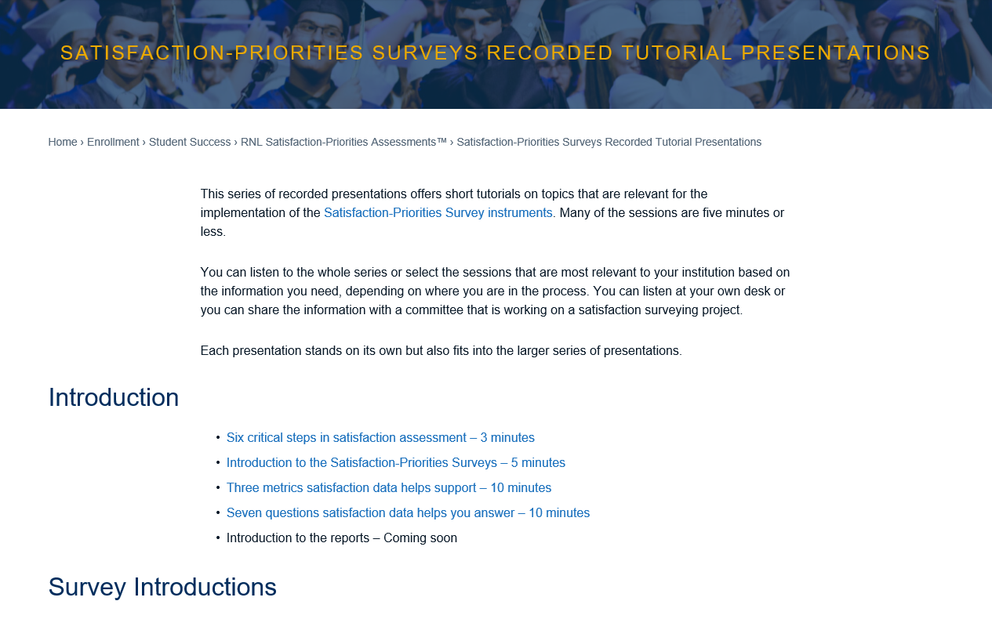
For a series of short tutorials, visit: www.RuffaloNL.com/SatisfactionSurveyTutorials
Notes:
There is additional on-demand content on the RNL Website that you and your team may be interested in reviewing. Most tutorials are only 5 to 7 minutes in length.

Slide 20
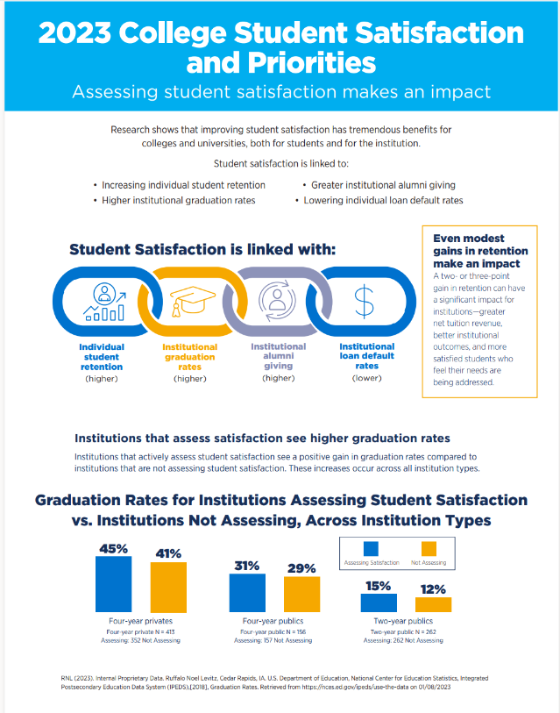
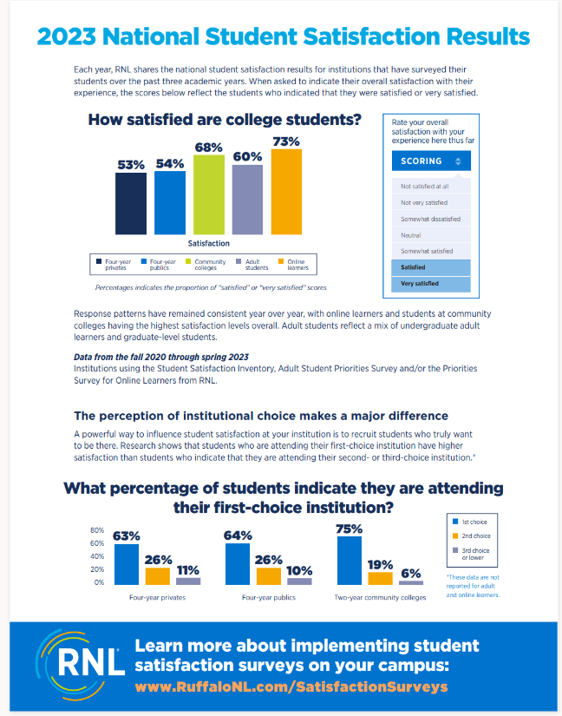
Download the 2023 National Student Satisfaction and Priorities Infographic
Also Available:
Top Strengths and
Challenges
by Institution Type
© Copyright 2023 Ruffalo Noel Levitz, LLC
2023 National Student Satisfaction and Priorities Report
RuffaloNL.com/Satisfaction

Slide 21


Learn more about the
RNL Satisfaction-Priorities Surveys
RuffaloNL.com/SatisfactionSurveys
Julie Bryant
Shannon Cook
Vice President for Student Success
Julie.Bryant@RuffaloNL.com
Senior Consultant Student Success Solutions
Shannon.Cook@RuffaloNL.com
Contact us with questions on the surveys or the reports

