Slide 1
Satisfaction-Priorities Surveys
Client Sample Materials
All materials shared with permission
Updated January 2021

Slide 2
Types of materials included
Posters
You Tube Video Links
Accreditation Documentation
Newsletters

Slide 3
1
Posters

Slide 9
2
YouTube Video

Slide 10
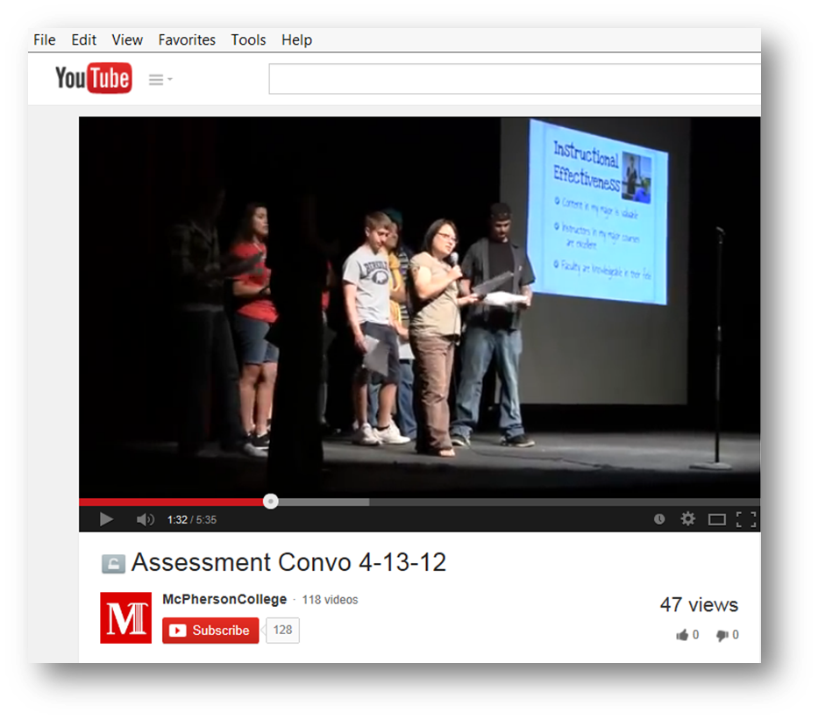
McPherson College Assessment Convocation
Students Sharing the SSI Results
http://www.youtube.com/watch?v=r9FTHDYpY-c

Slide 11
3
Accreditation Documentation

Slide 13
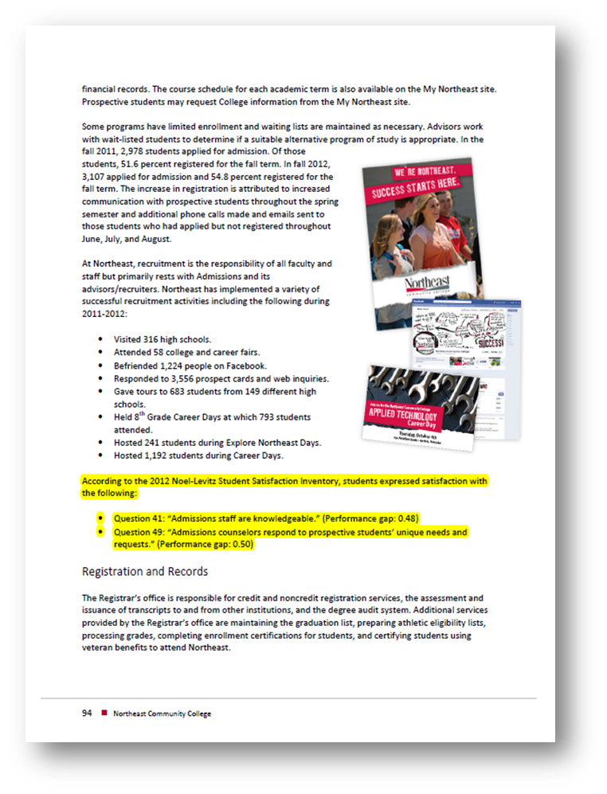
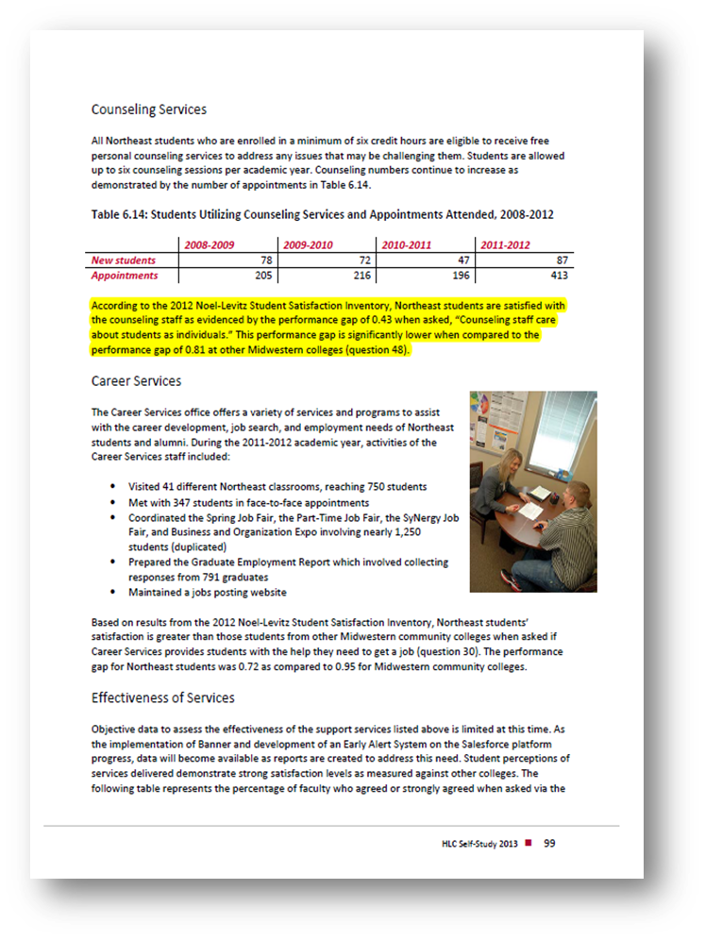

Slide 14
4
Newsletters

Slide 15
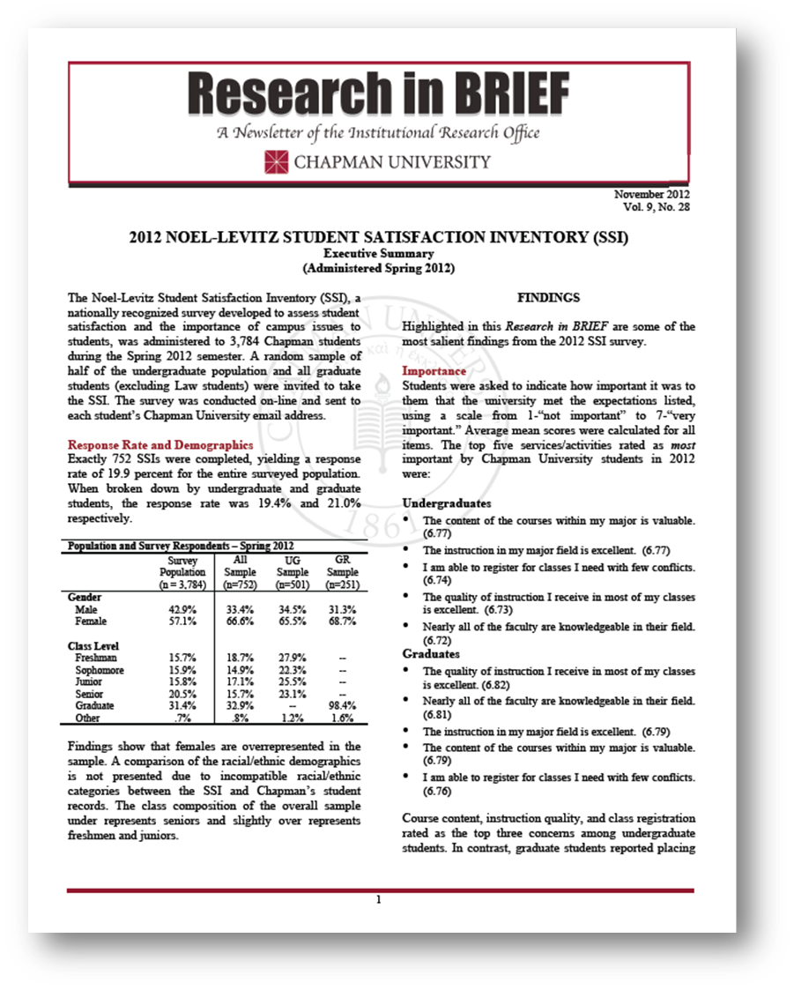
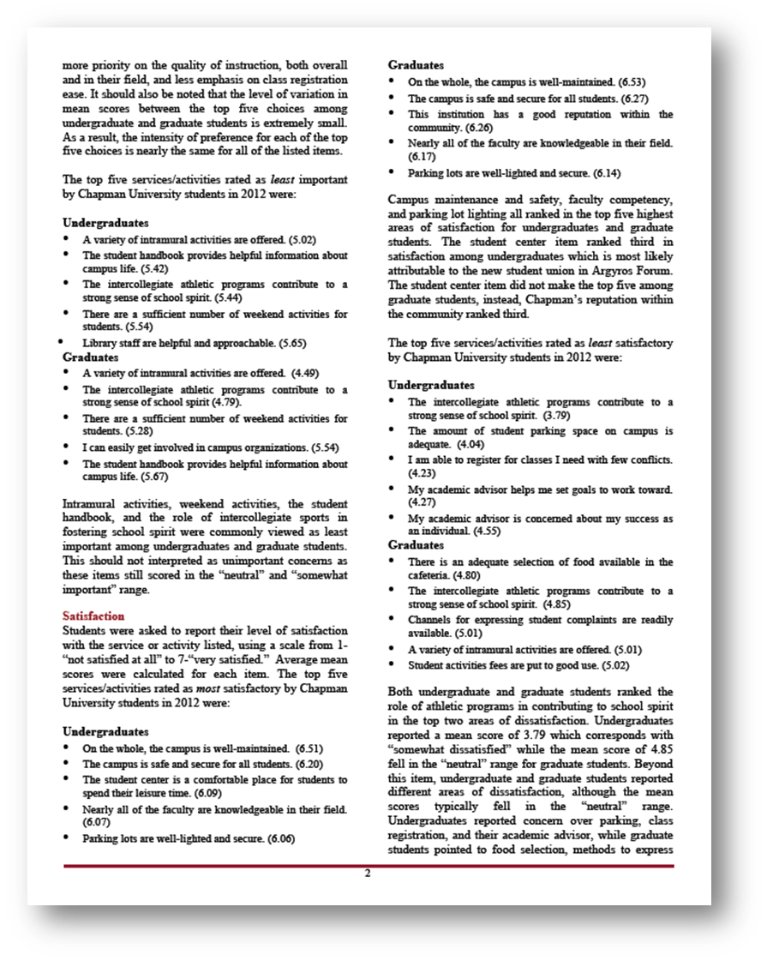

Slide 16
