Slide 1

Identification of student risk, receptivity
and outreach prioritization

Slide 2
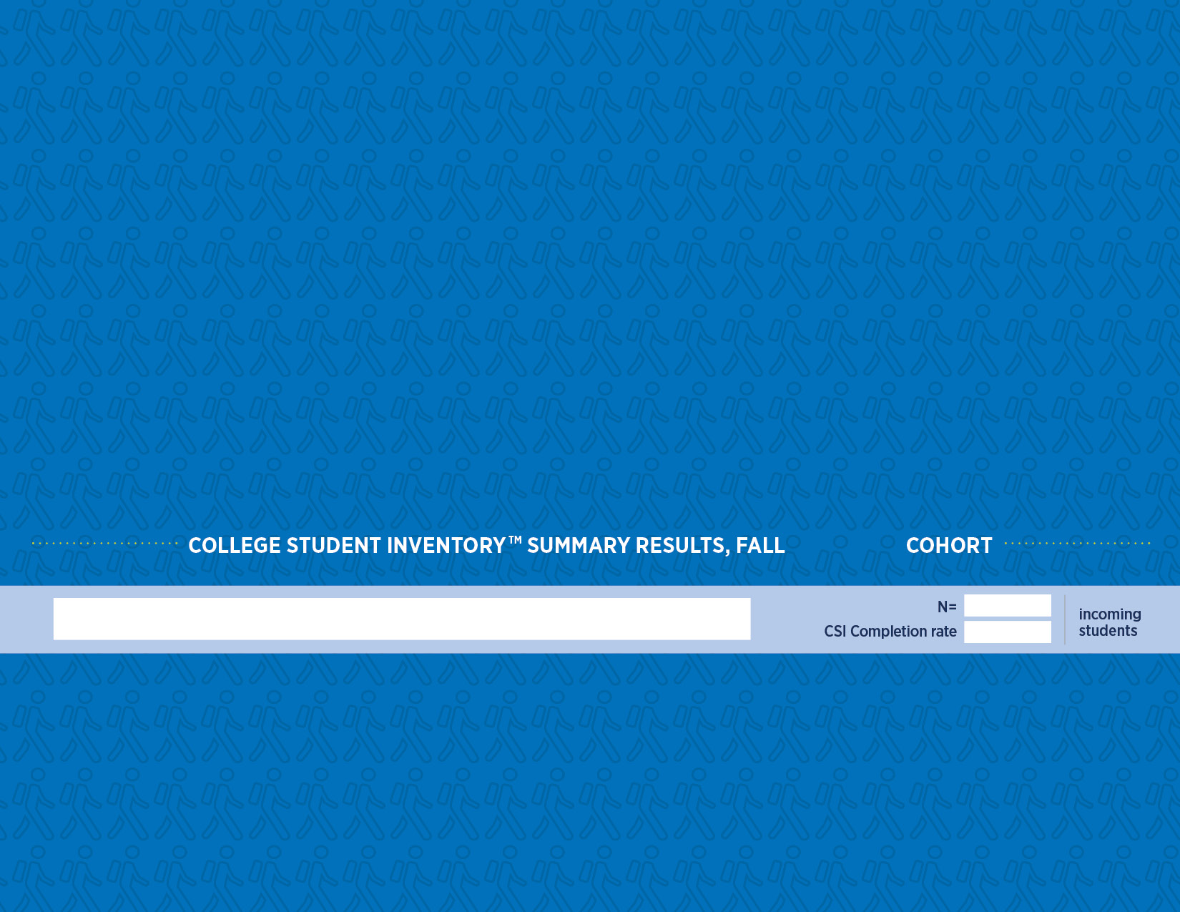
YOUR LOGO HERE
Identification of student risk, receptivity
and outreach prioritization
YEAR
School Name
#
%

Slide 3
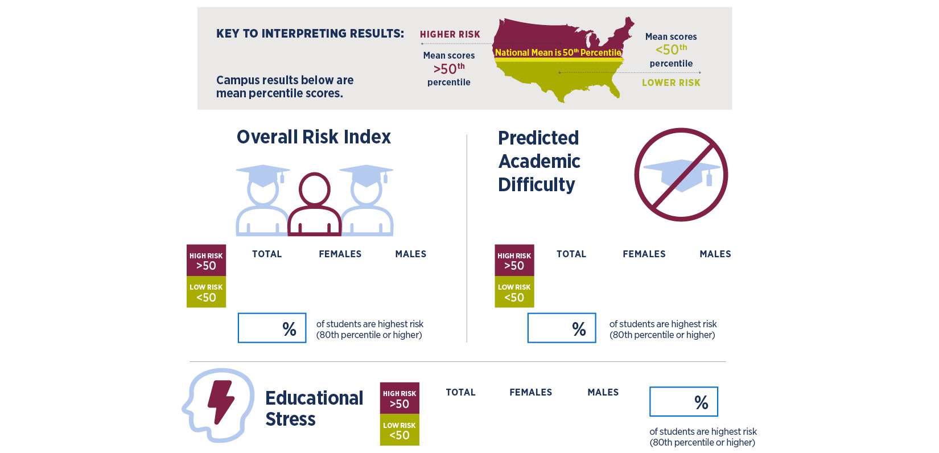
Are our students more or less at risk
than their peers nationally?
XX
XX
XX
XX
XX
XX
XX
XX
XX
XX
XX
XX

Slide 4
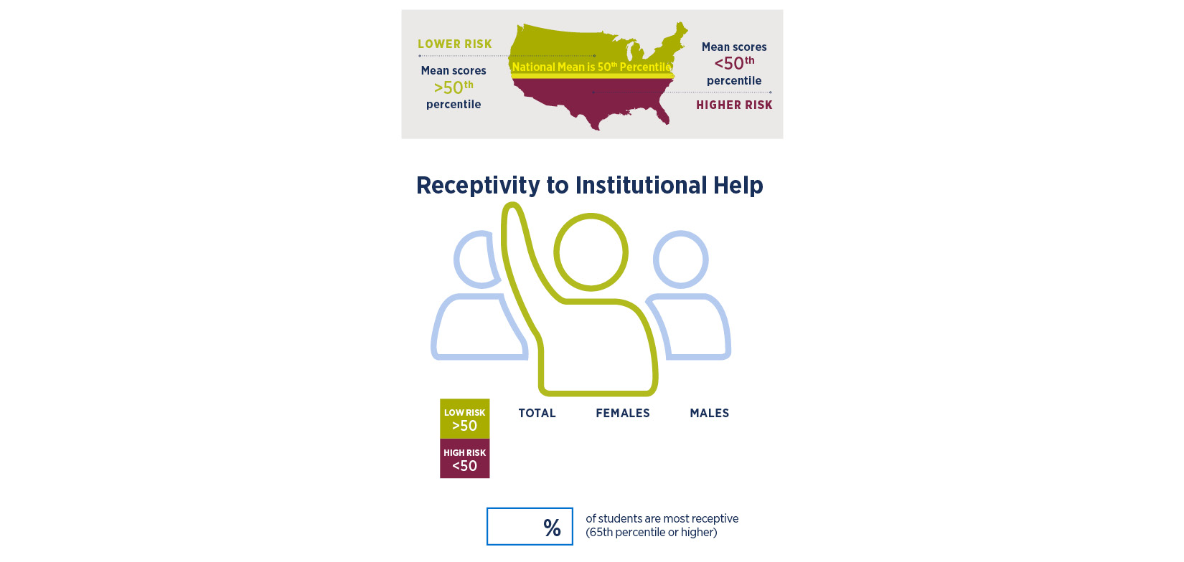
Are our students more receptive
to assistance?
XX
XX
XX
XX

Slide 5
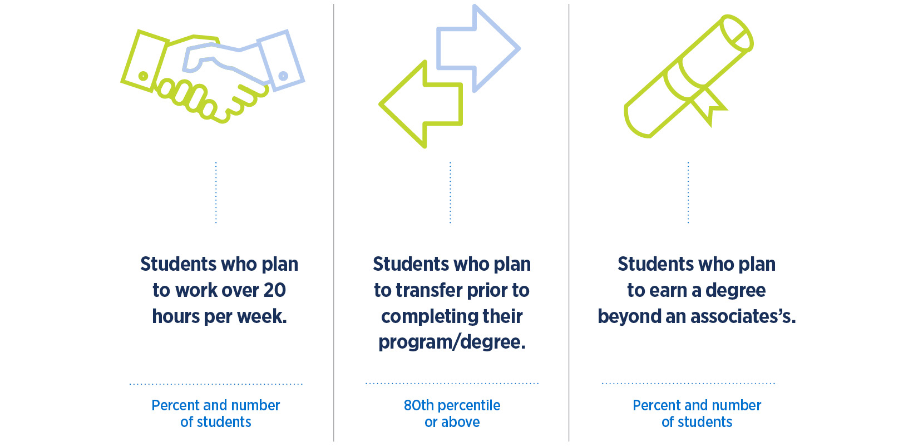
What are some key characteristics of this incoming class?
%
N
%
N
%
N

Slide 6
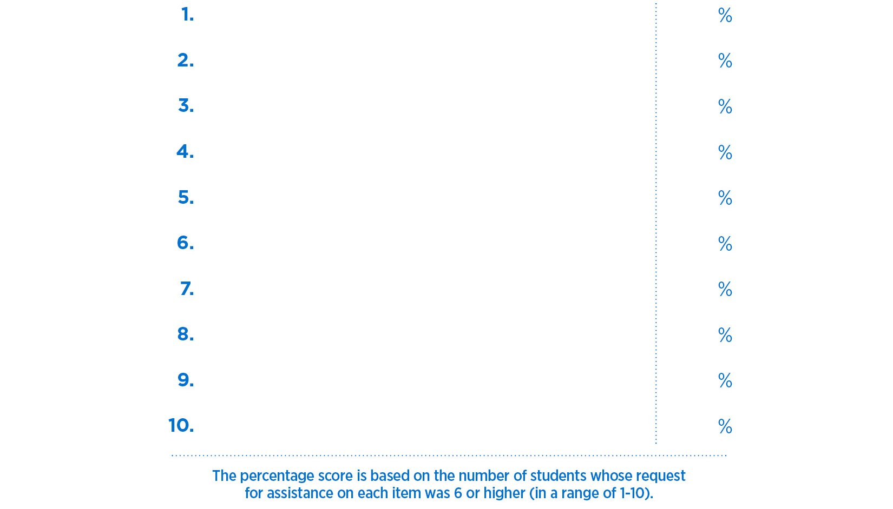
Students’ top 10 requests for assistance (Get Help/Discuss/Get Info)
First request
XX
Second request
XX
Third request
XX
Fourth request
XX
Fifth request
XX
Sixth request
XX
Seventh request
XX
Eight request
XX
Ninth request
XX
Tenth request
XX

Slide 7
How are we using this information?
Ways in which we are using these data:
List ways

Slide 8
How are we using this information?
Goals/Outcomes that we have set/achieved (optional):
List goals/outcomes (optional)

