Slide 1
Student Satisfaction and Priorities
Student Satisfaction Inventory™ (SSI)
Notes:
Note: Ruffalo Noel Levitz is RNL.

Slide 2
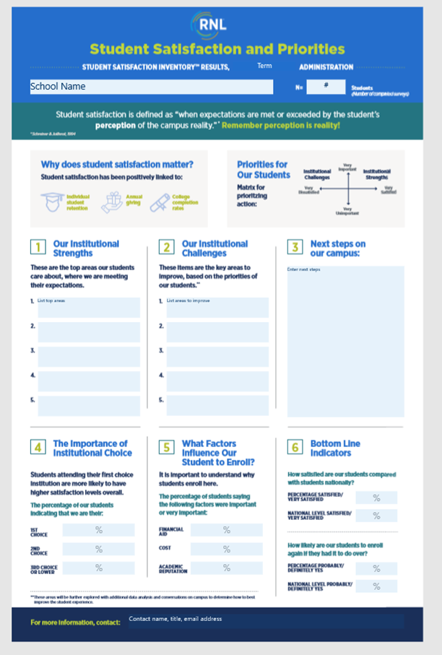
Student Satisfaction Inventory: Infographic
Use this PowerPoint template to match the data in the infographic.
Pull the same data points into this PowerPoint as you are highlighting in the infographic document.
Notes:
We encourage you to use and share both the infographic document and this PowerPoint template. The directions for populating the infographic can be found on the RNL Website.

Slide 3
The Student Satisfaction Inventory(SSI) administration at our institution
Notes:
You can customize this slide to include your institution name and logo as appropriate.

Slide 4
Definition of Satisfaction:
When expectations are met or exceeded by the student’s perception of the campus reality.
Schreiner & Juillerat, 1994
Notes:
What is satisfaction? The authors of the Student Satisfaction Inventory define it as, “when expectations are met or exceeded by the student’s PERCEPTION of the campus reality. You can see that a key word in this definition is PERCEPTION and it is important to keep in mind that perception really is reality. The other important word here is EXPECTATIONS because they provide the context with which to consider the student experience. Regardless of what we think the situation may be on our campus, it is the students’ perceptions that matter because that is their reality.

Slide 5
Why measure student satisfaction and priorities?
Evidence-based research has documented strong links between students’ scores on RNL Satisfaction-Priorities Surveys with several areas, including…
To review the research: www.RuffaloNL.com/Benchmark
Notes:
Research has shown that there are links between student satisfaction and higher individual student retention, higher institutional graduation rates and higher institutional alumni giving. These are all metrics that are regularly tracked by colleges and universities and it important to know that student satisfaction can have a positive impact on these areas. To see the full reports that support these observations, go to RuffaloNL.com/benchmark.

Slide 6
Four primary ways to use satisfaction data
Retention
Strategic Planning
Accreditation
Recruitment
Notes:
Institutions have shared with RNL that they use satisfaction data for a variety of efforts on their campuses. These include using the data
For retention and student success efforts. Campuses are using their identified strengths to re-recruit their current students by reminding them of what the college does well according to their student reported data.
They are also using the data to provide the student voice in strategic planning activities
The satisfaction data are certainly valuable for documentation with your accreditation efforts, where the items have been mapped to the regional accreditation criteria
And campuses are using the data for recruitment efforts-highlighting their strengths in their marketing messages in order to attract students who value what they do well.
We will want to look for ways to expand the use of our data on campus to ultimately broaden our return on your investment.

Slide 7
Definitions
Strengths: Survey items that students rated in the top half of importance and in the top quartile of satisfaction, relative to the other survey items.
Challenges: Survey items in the top half of importance and the bottom quartile of satisfaction or in the top half of importance and the top quartile of the performance gaps for the data set.
Performance gap: The difference between the importance score and the satisfaction score.
Notes:
Before we take a closer look at the findings, I want to share with you how RNL defines institutional strengths and institutional challenges. Strengths are items of high importance and high satisfaction. These are the items that students care about that should be celebrated because the institution is performing relatively well. Challenges are those items that are also very important to students, but have lower satisfaction scores or large performance gaps. These are the priority areas for attention at the institution because students reflect high expectations but believe there is room for improvement. And performance gaps are simply the importance score minus the satisfaction score. The larger the gap, the greater the difference between what students expect and their perception of their current experience. Keep in mind that these results are all student perceptions, but we also know that perception is reality.

Slide 8
Matrix for prioritizing action
Institutional
Challenges
Very Important
Institutional
Strengths
Very Dissatisfied
Very Satisfied
Very Unimportant
Copyright to 1994-2019 Ruffalo Noel Levitz
Notes:
A visual way to think about the identification of the strengths and challenges is with this matrix for prioritizing action which reflects the core conceptual concept of the RNL satisfaction and priorities surveys. We will want to stay focused on the items that are in the top half of importance for our students.

Slide 9
Our survey administration
This equals
XX%
response rate
The Student Satisfaction Inventory was administered in the fall of 2019
A total of XXX of students completed the survey.
XXXX students were invited to complete the survey online.
Notes:
CUSTOMIZE this slide with your administration timeframe, as well as the total number of students who completed the survey, the number invited and your response rate percentage.

Slide 10
Our institutional strengths
These are the top areas our students care about, where we are meeting their expectations:
Notes:
CUSTOMIZE this slide, entering your top 5 strengths as listed in the Strategic Planning Overview tab of your HTML interactive report. Note: You are welcome to reflect ALL of your strengths and not just the top 5.

Slide 11
Our institutional challenges
These are the key areas to improve, based on the priorities of our students:
Notes:
CUSTOMIZE this slide, entering your top 5 challenges as listed in the Strategic Planning Overview tab of your HTML interactive report. Note: You are welcome to reflect ALL of your challenges and not just the top 5.

Slide 12
The importance of institutional choice
Students attending their first choice institution are more likely to have higher satisfaction levels overall.
Notes:
CUSTOMIZE this slide: Enter the percentage of students (rounding as necessary) that indicated you are their first choice, second choice, and third choice. This information can be found in your Demographic Report.

Slide 13
What factors influence our students to enroll?
It is important to understand why students enroll here. The percentage of student saying the following factors were important or very important:
Notes:
CUSTOMIZE this slide: Enter the percentage of students that indicated each factor was important/very important. This information can be found at the bottom of the Item Percentage Report in the HTML interactive results.

Slide 14
Bottom line indicator: Satisfaction
How satisfied are our students compared with students nationally?
NOTE: UPDATE THE GRAPH WITH YOUR PERCENTAGES AND ADJUST THE AXIS AS APPROPRIATE
Notes:
CUSTOMIZE this slide: Enter the percentage of students that indicated they were satisfied or very satisfied, along with the corresponding information on the national level. This information can be found in the Summary Report in the HTML interactive results. Add together the responses for satisfied / very satisfied in each column. Be sure to delete the note that instructs you to update the graph.

Slide 15
Bottom line indicator: Re-enrollment
How likely are our students to enroll again if they had it to do over, compared with students nationally?
NOTE: UPDATE THE GRAPH WITH YOUR PERCENTAGES AND ADJUST THE AXIS AS APPROPRIATE
Notes:
CUSTOMIZE this slide: Enter the percentage of students that indicated they would probably yes or definitely yes re-enroll, along with the corresponding information on the national level. This information can be found in the Summary Report in the HTML interactive results. Add together the responses for probably yes / definitely yes in each column. Be sure to delete the note that instructs you to update the graph.

Slide 16
Next steps on our campus:
These are our planned next steps with using the data on campus:
List ways here
Notes:
CUSTOMIZE this slide: Enter the next steps you plan to take on your campus. Some examples include:
The college will be conducting focus groups with students on campus to better understand how the challenge items are interpreted.
We will also be sharing the results more widely with faculty, staff, administration, alumni and the entire student body through a variety of communication vehicles.
Additional data slicing will be done to better understand how students in various demographic subpopulations feel about their experience here, so responses can be targeted appropriately.

Slide 17
How are we using this information?
Goals/outcomes that we have set/achieved (optional):
List goals/outcomes (optional)
Notes:
CUSTOMIZE this slide as appropriate. Indicate your goals for how you expect to use these data.

Slide 18
Systematic Assessment Cycle
Inform the campus
Survey your students
Respond to the data with new initiatives
Review and share the results
Explore the data
Notes:
You can share this slide as appropriate. This is a recommended five step assessment cycle to actively review, share, explore and use your data, as well as close the feedback loop by informing the campus, especially before you survey again.

Slide 19
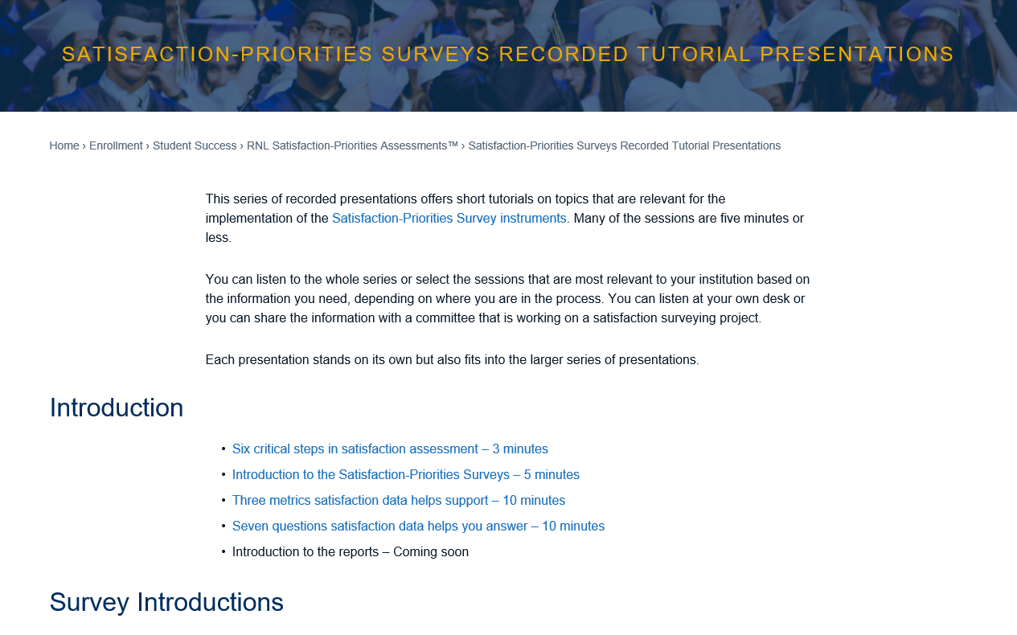
For a series of short tutorials, visit: www.RuffaloNL.com/SatisfactionSurveyTutorials
Notes:
There is additional on-demand content on the RNL Website that you and your team may be interested in reviewing. Most tutorials are only 5 to 7 minutes in length.

Slide 20
Download the report from here:
www.RuffaloNL.com/Benchmark
Results from the RNL Student Satisfaction Inventory™ (SSI), RNL Adult Student Priorities Survey™ (ASPS) or the RNL Priorities Survey for Online Learners™ (PSOL)
Notes:
You may also want to download the 2019 national student satisfaction and priorities report. The results from this report are based on the students completing the RNL Student Satisfaction Inventory or the Adult Student Priorities Survey or the Priorities Survey for Online Learners. The 2019 report looks at trends across the past ten years.

Slide 21
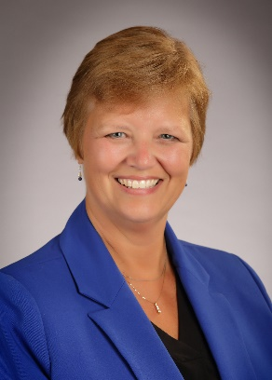
Learn more about the RNL Satisfaction-Priorities Surveys:
www.RuffaloNL.com/SatisfactionSurveys
Julie Bryant Associate Vice President
Julie.Bryant@RuffaloNL.com
319.247.4735
Shannon Cook Senior Director
Shannon.Cook@RuffaloNL.com 319.247.4736
Notes:
Please contact Julie Bryant or Shannon Cook at RNL with any questions.

